Slide 1
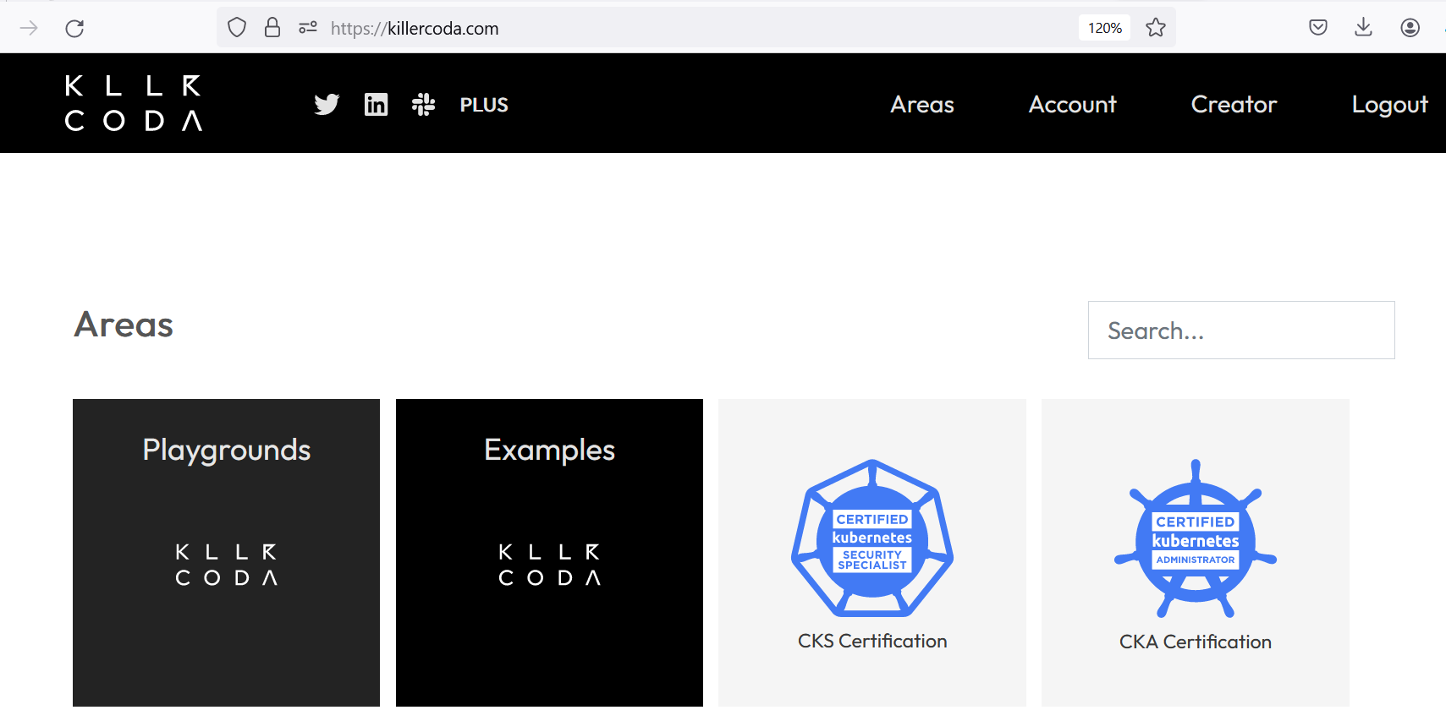
Step1: Lab setup > https://killerkode.com

Slide 2
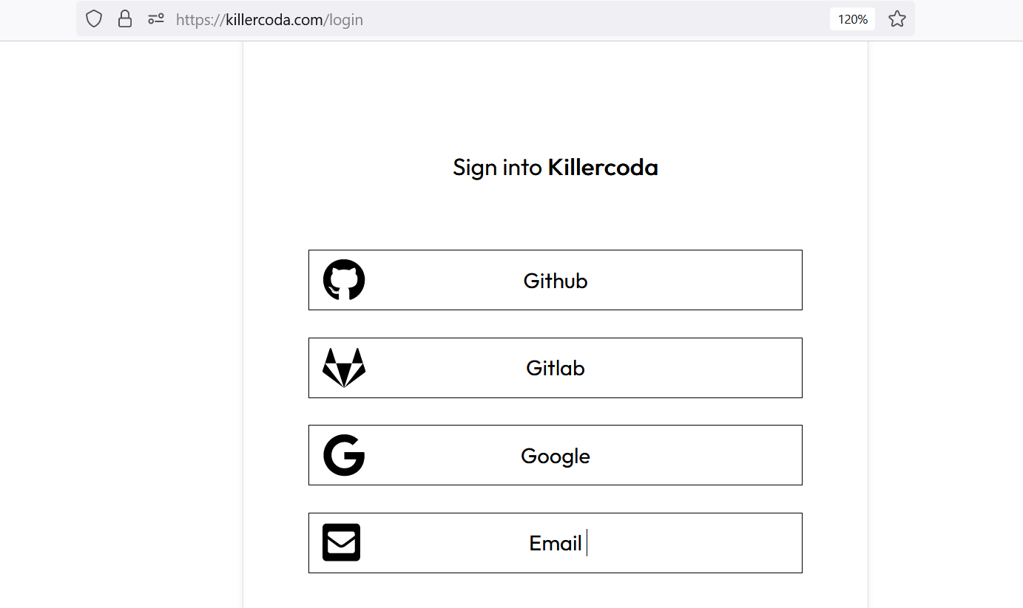
Login option

Slide 3
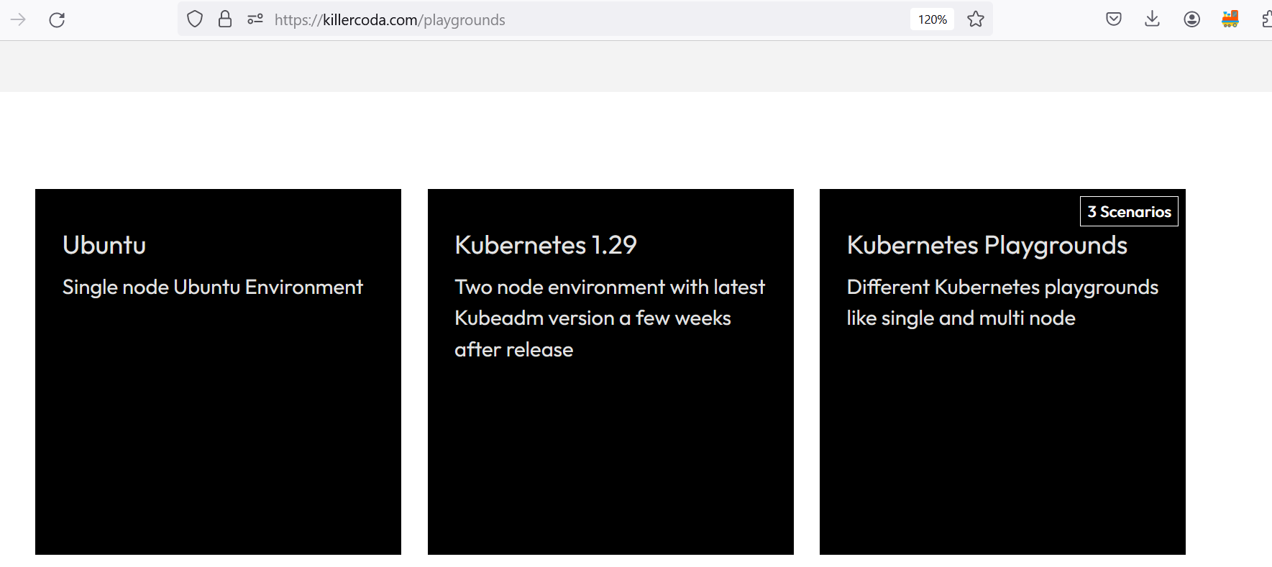
Select ubuntu playground

Slide 4
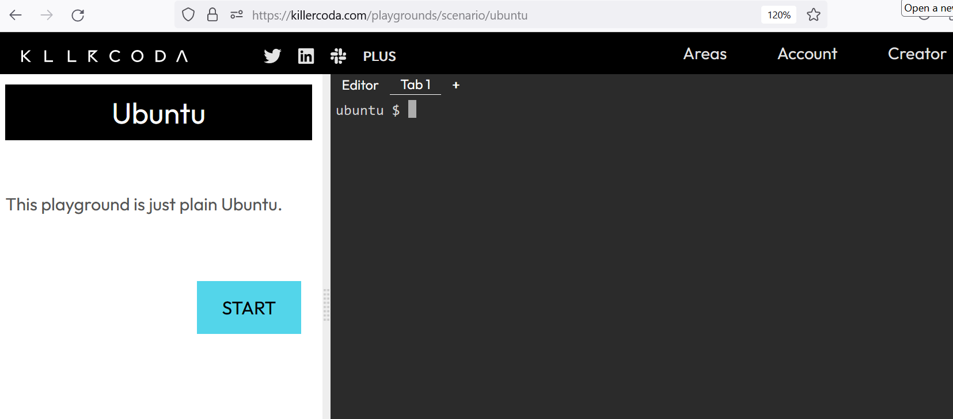
Ubuntu terminal

Slide 5
Step2-Terraform installation on Ubuntu
https://developer.hashicorp.com/terraform/install

Slide 6
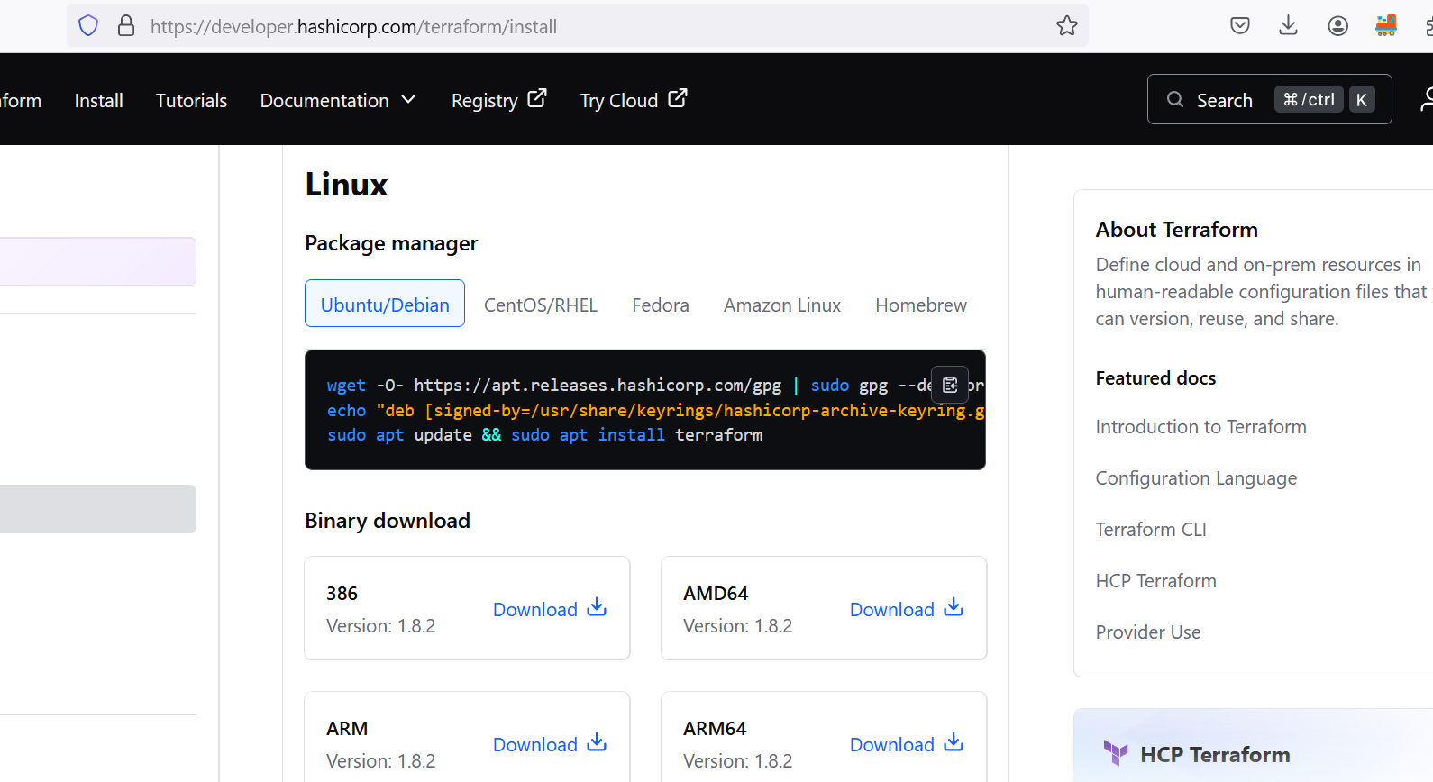

Slide 7
Step3: Authenticate killerkoda with Azure
Step3.1: Azure CLI installation
===================
curl -sL https://aka.ms/InstallAzureCLIDeb | sudo bash
Step3.2: Authentication with Azure for proceeding further
===================================
ubuntu $ az login
To sign in, use a web browser to open the page https://microsoft.com/devicelogin and enter the code XXXXXXXXX to authenticate.

Slide 8
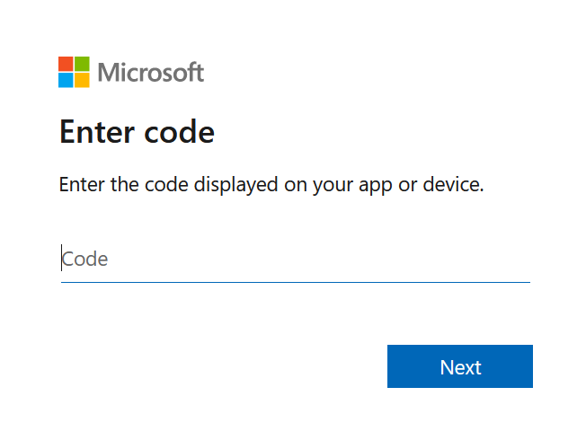
Open the URL into browser and enter the code

Slide 9
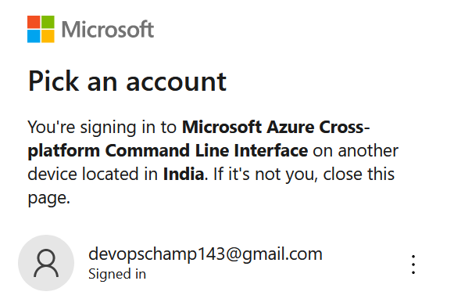
Select the Azure Account with active subscription

Slide 10
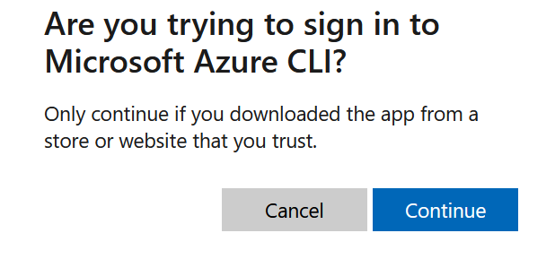
Click on continue

Slide 11
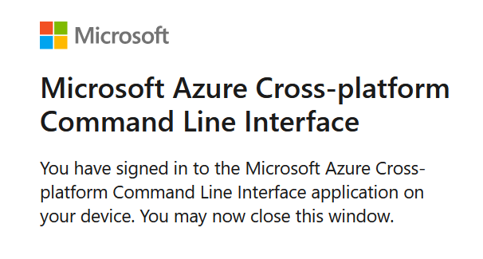
Message after clicking on continue

Slide 12
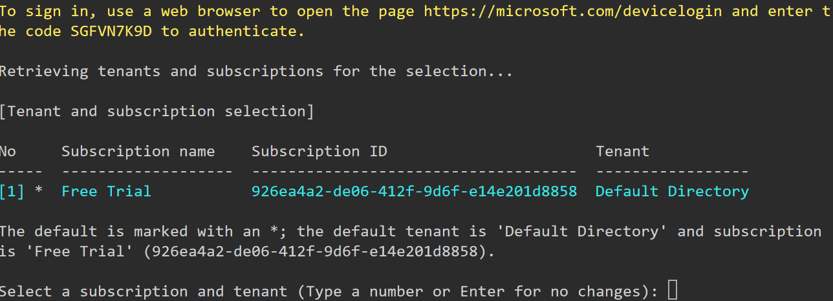
Next SEP
Now, come to linux terminal, you must be seeing like this, click on enter

Slide 13
How to write terraform code?
Prework: Identify the cloud provider, and what you want to create.

Slide 14
Basic programming and their extension
C > PROGRAMNAME.C
JAVA> PROGRAMNAME.JAVA
C++> PROGRAMNAME.CPP
Terraform> PROGRAMNAME.tf [main.tf by default]

Slide 15
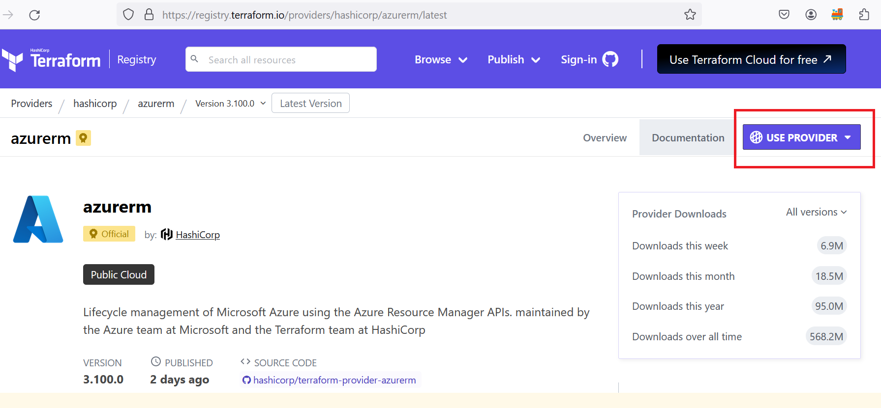
Providers documentation

Slide 16
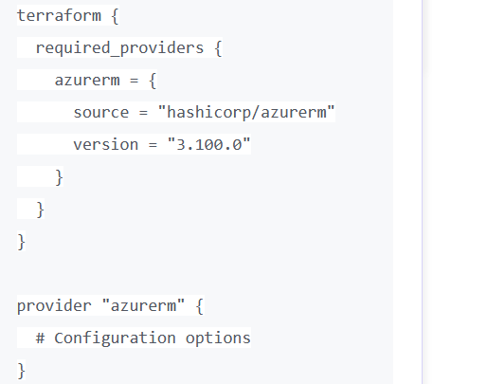
Main.tf

Slide 17
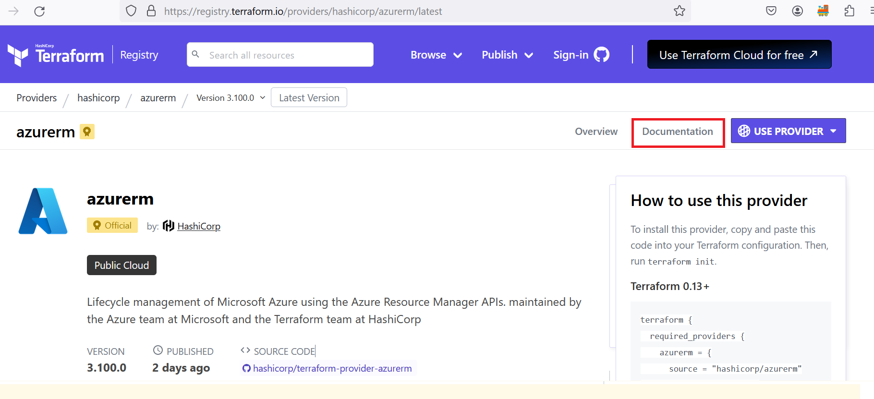
Azure documentation

Slide 18
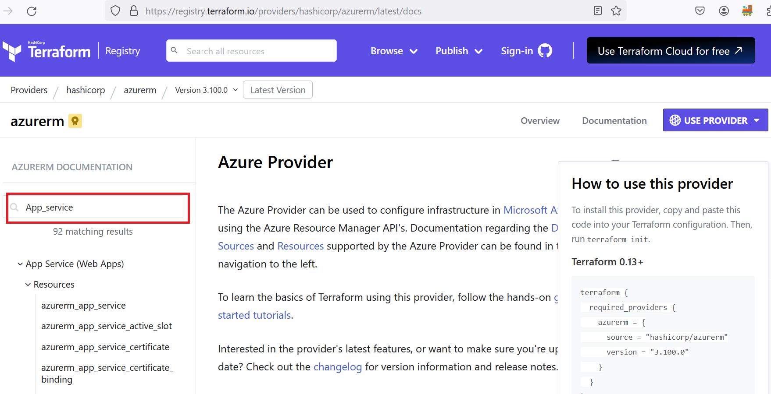

Slide 19
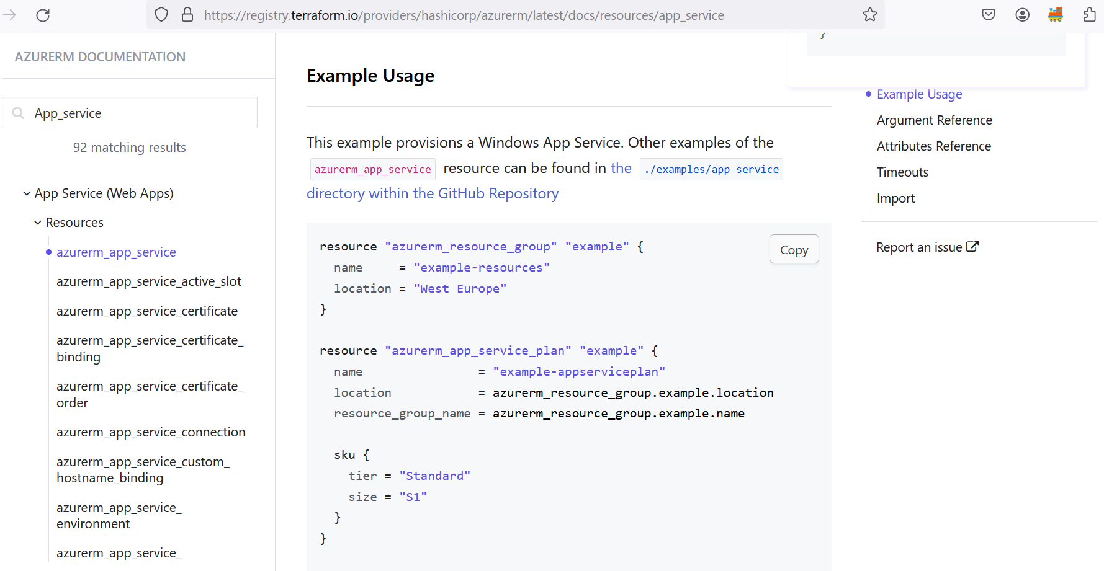

Slide 20
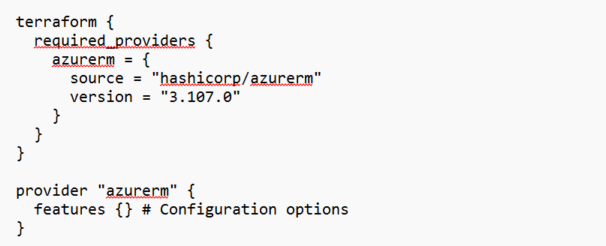
Write main.tf with desire configuration
Below Code is mandatory code

Slide 21
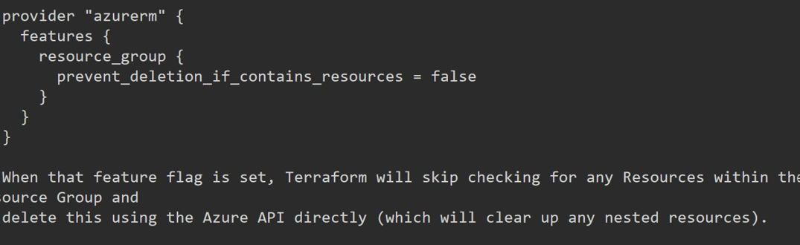
Fearture block explaination
If we are not writing any block, it means we are using all default block

Slide 22
Terraform Cycle
terraform init > Initialization purpose.
terraform apply > to create infrastructure.
terraform destroy > to delete infrastructure.
Note: Make sure you are entering yes after terraform apply, and terraform destroy

